Slide 1
Hardware Components in Computer Graphics

Slide 2
3 elements of computer graphics
Hardware - the physical devices that can be seen occupying space
Software– the computer programs that allow the system to be used effectively for computer graphics applications.
Operator– the user of the hardware and software.

Slide 3
3 categories of hardware
Computers
  Categorized by platforms
Output or display devices
  plotters - produce pictures or drawings for people to use in their works
  video display devices - show an electronic version of a picture.
Input devices
  pointing devices that positioning cursors on the display

Slide 4
Computer Platforms
PCs vs. MacIntoshs
PCs are generally used the business, legal, and engineering fields
Macs tend to have a niche in the art, video production and web design fields.

Slide 5
MAC and Computer Graphics
  MacIntosh is a better product for graphic designers, especially those of printed media, because of following reasons.
  Better graphic card
  CYMK color scheme
  Compatibility of hardware
  Many graphic applications are Macs exclusive
  Focusing on graphic design market

Slide 6
Silicon Graphics Workstation (SGI)
Workstation design especially for complicate graphics such as 3D environment
i.e. Movie and entertainment industry.

Slide 7
Video Display Devices (Output)
2 most important devices in CG
  Monitor
  Video Cards

Slide 8
Monitors
Your monitor plays a significant role in the following important aspects of your computer system:
  Comfort and Ergonomics: poor quality monitors lead directly to eyestrain and other problems, and can ruin the computing experience
  Software and Video Mode Support: use of high resolution or high color-depth video modes requires support for theses modes from the monitor
    video card that can drive high resolutions in true color at high refresh rates is useless without a monitor that can handle them as well
  Upgradeability

Slide 9
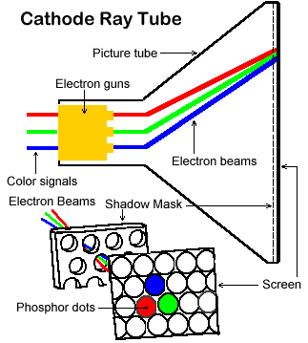
Cathode Ray Tube (CRT)

Slide 10
The Shadow Mask
To create a precise and crisp picture, it is necessary to make sure that the electron beam for each color strikes only the correct dots intended for use for that color. The normal way that this is done is by using a fine metal mesh called a shadow mask.
The shadow mask is designed to the same shape as the surface of the CRT, and the electron beams shine through the mask. By carefully positioning the mask, the beams only strike the correct dots.

Slide 11
Aperture Grill
Instead of a metal mesh, this type of tube uses many hundreds of fine metal strips that run vertically from the top of the screen surface to the bottom. These strips perform the same function as the shadow mask--they force the electron beam to illuminate only the correct parts of the screen.

Slide 12
Advantages of Aperture Grill
It allows more of the electron beam to pass through to the phosphor; this results in what many consider to be a brighter and shaper overall picture.
This type of tube is flat vertically which result in flat screen = Reduce glare and less distort images

Slide 13
Disadvantages of Aperture Grill
  Thin metal strips don't have the same physical stability as a metal sheet with holes in it (the shadow mask). This means that the metal strips can tend to vibrate.
  To correct this problem, one, two or three thin stabilizing wires are run horizontally across the screen –causing the appearance of very faint lines where the stabilizing wires are.

Slide 14
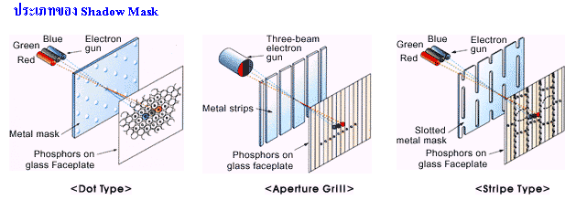
Shadow masks and Aperture Grills

Slide 15
Quality of a CRT Monitor
Depends largely on its resolution, dot pitch, and refresh rate
Resolution describes the sharpness and clearness of an image
Manufacturers state the resolution of a monitor in pixel
  Example: 800 X 600
A pixel (picture element) is a single point in an electronic image
  A pixel is the smallest element in an electronic image

Slide 16
Quality of a CRT Monitor
Setting a monitor to display a higher resolution uses a greater number of pixels and thus provides a smoother image
Larger monitors typically look best at a higher resolution, and smaller monitors look best at a lower resolution

Slide 17
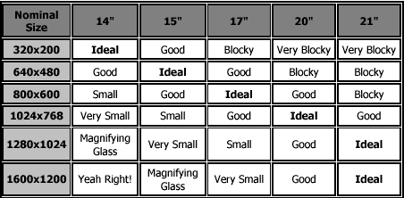
Size and Resolution Matching
Quality of a CRT Monitor

Slide 18
Quality of a CRT Monitor
Dot Pitch
  The distance between adjacent sets of red, green and blue dots.
  The dot pitch of the monitor indicates how fine the dots are that make up the picture.
  The smaller the dot pitch, the more sharp and detailed the image.

Slide 19
Quality of a CRT Monitor
Refresh rate
  When electron beam strikes a dot in CRT, the surface of the CRT only glows for a fraction of a second and then fades.
  Monitor must redraw the picture many times per second to avoid having the screen flicker
  The refresh rate is the number of times per second that monitor redraws the images on the screen.
  Very few people notice flicker at refresh rates above 72 Hz.
  Higher refresh rates are preferred for better comfort in viewing the monitor

Slide 20
Typical sizes for CRT
15, 17, 19, 21, and 22 inches
Monitor measured diagonally from one corner of the casing to the other
4:3 Ratio

Slide 21
LCD (Liquid Crystal Display)
LCD (Liquid Crystal Display)
  A type of flat-panel display
  Uses liquid crystals between two sheets of material to present information on a screen
  An electric current passes through the liquid crystals, they twist
  Depending on how much they twist, some light waves are passed through while other light waves are blocked. This creates the variety of color that appears on the screen

Slide 22
How LCD works?
Step 2. As light passes through liquid crystal, electrical charge causes some of the cells to twist, making light waves bend as they pass through color filter.
Step 1. Panel
of fluorescent
tubes emits
light waves
through
polarizing glass filter, which guides light toward layer of liquid crystal cells.
Liquid crystal cells
Step 3. When light reaches second polarizing glass filter, light is allowed to pass through any cells that line up at the first polarizing glass filter. Absence and presence of colored light cause image to display on the screen.
Transparent electrodes
Alignment layer
Color filter
Polarizing glass filter
Fluorescent tube panel

Slide 23
LCD (Liquid Crystal Display)
LCD monitors produce color using either passive-matrix or active-matrix technology
Active-matrix display, also known as a TFT (thin-film transistor) display, uses a separate transistor to apply changes to each liquid crystal cell and thus display high-quality color that is viewable from all angles

Slide 24
LCD (Liquid Crystal Display)
Passive-matrix display uses fewer transistors and requires less power than an active-matrix display
The color on a passive-matrix display often is not as bright as an active-matrix display
Users view images on a passive-matrix display best when working directly in front of it
Passive-matrix displays are less expensive than active-matrix displays

Slide 25
LCD (Liquid Crystal Display)
An importance measure of LCD monitors is the response time, which is the time in millisecond (ms) that it takes to turn a pixel on or off
LCD monitors’ response times average 25 ms
The lower the number, the faster the response time
Brightness of an LCD monitor is measured in nits
Nit is a unit of visible light intensity equal to one candela meter
Resolution and dot pitch determines quality of LCD monitor

Slide 26
Gas plasma monitor
A flat-panel display that uses gas plasma technology
A layer of gas between two sheets of material
When voltage is applied, the gas releases ultraviolet (UV) light that causes the pixels on the screen to glow and form an image
Larger screen sizes and higher display quality than LCD, but much more expensive

Slide 27
Video Cards and CRT Monitors
Many CRT monitors use an analog signal to produce an image
Video card converts digital output from the computer into an analog video signal and sends the signal through a cable to the monitor
  Also called a graphics card

Slide 28
Video Cards and CRT Monitors
The number of colors a video card displays is determined by its bit depth
The video card’s bit depth, also called the color depth, is the number of bits it uses to store information about each pixel
i.e. 8-bit video card uses 8 bits to store information about each pixel; this video card can display 256 colors (2x2x2x2x2x2x2x2)
i.e. 24-bit video card uses 24 bits to store information about each pixel and can display 16.7 million colors
The greater the number of bits, the better the resulting image

Slide 29
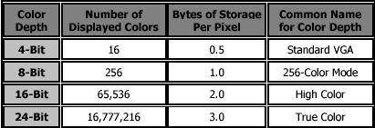
Pixel Color and Intensity, Color Depth

Slide 30
Video Display Standards
Video Electronics Standards Association (VESA), which consists of video card and monitor manufacturers, develops video stands to define the resolution, number of colors, and other display properties.
  Monochrome Display Adapter (MDA)
  Hercules Graphics Card
  Color Graphics Adapter (CGA)
  Enhanced Graphics Adapter (EGA)
  Video Graphics Adapter (VGA)
  Super VGA (SVGA) and Other Standards Beyond VGA

Slide 31
Monochrome Display Adapter (MDA)
Established by IBM
Monochrome-only, text-only standard
Resolution of 720x350 at a refresh rate of 50 Hz

Slide 32
Hercules Graphics Card
A company named Hercules created in the early 80s an MDA-compatible video card that supported monochrome graphics in addition to the standard text modes.
Support for the card was included in popular software packages such as Lotus 1-2-3 to allow the display of graphs and charts on the computer screen.

Slide 33
Color Graphics Adapter (CGA)
The CGA supports several different modes
  The highest quality text mode is 80x25 characters in 16 colors.
  Graphics modes range from monochrome at 640x200 (which is worse than the Hercules card) to 16 colors at 160x200

Slide 34
Enhanced Graphics Adapter (EGA)
EGA allowed graphical output up to 16 colors at screen resolutions of 640x350, or 80x25 text with 16 colors, all at a refresh rate of 60 Hz .
Used for Windows 3.x

Slide 35
Video Graphics Adaptor (VGA)
True VGA supports 16 colors at 640x480 resolution, or 256 colors at 320x200 resolution
They use output signals that are totally different than those used by older standards. Older displays sent digital signals to the monitor, while VGA (and later) send analog signals.

Slide 36
Super VGA and Other Standards Beyond VGA
SVGA (Super VGA), a resolution of 800X600.
SXGA (Super XGA), a resolution of 1280X1024
UGA (Ultra XGA), a resolution of 1600X1200

Slide 37
Video Cards
Video card must have enough memory to generate the resolution and number of color you want to display
The memory in a video card stores information about each pixel
Video cards use many types of video memory
  VRAM (video RAM), WRAM (window RAM), SGRAM (synchronous graphics RAM) or SDRAM (synchronous DRAM)

Slide 38
Video Cards
In addition to memory chips, the video card contains a processor chip, sometimes called a graphics processing unit (GPU) because it performs calculations used to display images on the screen

Slide 39
BUS
Computer processes and stores data as a series of electronic bits
These bits transfer internally within the circuitry of the computer along electrical channels
Each channel, called a bus, allows the various devices both inside and attached to the system unit to communicate each other

Slide 40
BUS
System bus connects the processor to the main memory
Expansion bus
  PCI bus (Peripheral Component Interconnect bus): the current local bus because it is more versatile than the VESA local bus
  Accelerated Graphics Port (AGP): designed by Intel to improve the speed with which 3-D graphics and video transmit.
  With an AGP video card in an AGP bus slot, the AGP bus provides a faster, dedicated interface between the video card and memory

Slide 41
Input Devices
Keyboard, mouse, scanner, digital pen, and cursor

